Slide 1
March, 2017
Digital Marketing Proposal

Slide 2
About Us
[Your company] are a digital marketing agency specialized in [Niche]. We help [Niche] business to increase their exposure using SEO. Our team consists of an experience SEO specialists who ranks hundred of [target market] to be on the first page of search engine. Not only Google, but we also expert in Bing, Yahoo and other search engine. These skills will help you to rank easier on the search engine, in the same time, increase exposure to your potential leads.

Slide 3
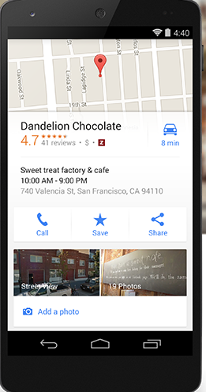
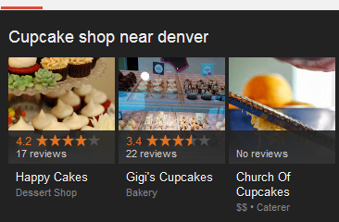
Local Search
According to Google, 20 percent of Web searches have local intent, and that number jumps to 40 percent for mobile searches.
Google now processes over 40,000 search queries every second on average
People check their phones 150 times a day, according to Kleiner Perkins Caufield & Byers’s annual Internet Trends report.

Slide 4
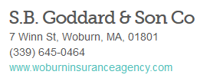
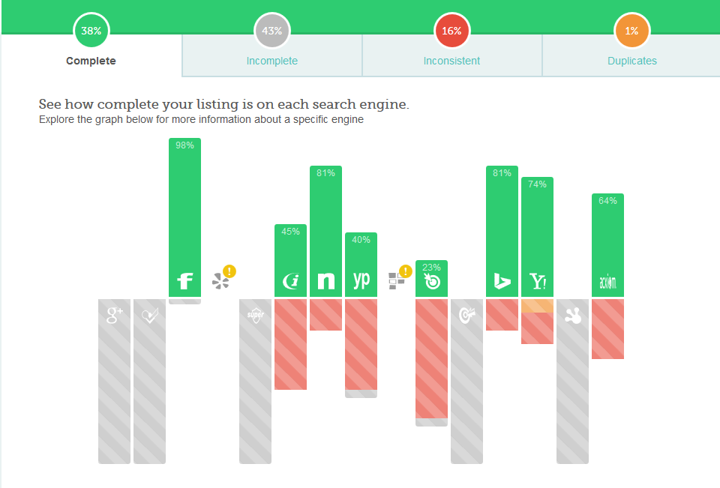
Local Opportunity
We are missing a lot of prime advertising space with off-site sources. Your NAP (Name, Address, and Phone) needs to be added correctly with citations to directories.

Slide 5
Proposed Services.

Slide 6
Local Search
Company Name - $500/mo
Monthly Fee Includes:
❏ Proper listing verification
❏ Long-term, fully optimized listing
❏ Premium optimized video and images
❏ 10 geo tag photos
❏ Creation of listing logo
❏ Citation clean up and building
❏ Google Plus and YouTube synched
❏ On-site content creation (Keyword HyperFocus)
❏ Schema markup integration
❏ Keyword tracking
❏ Monthly reporting
❏ Strategic Forecasting

Slide 7
Monthly Timeline
1-3
4-6
7-9
10-12
Ongoing
Set Up in Tools
Business Verification
Keyword Research
Citation Audit
Photo Citations
Listing Optimization
Monthly Reporting
Landing Page Evaluation
Photo Citations
Schema Markup
Geo-Location Research
Competitor Evaluations
Account Reviews
Monthly Reporting
Citation Building
Video Citations
Content Evaluation
Content Generation
Website Performance
Competitor Standings
Monthly Reporting
Citation Building
Content Generation
Keyword Research
Ad Hoc deliverables
Social Posting
On-site Optimization
Monthly Reporting
Review of Account
Geo Expansion
Prioritized
Citation Building
Maintenance
Social Posting
Monthly Reporting

Slide 8
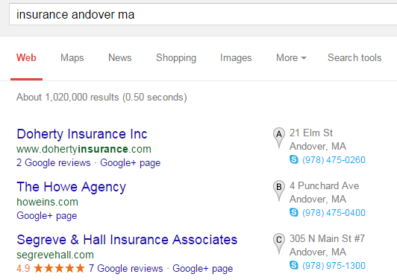
A case study
Objective
Segreve & Hall were looking to acquire more insurance leads for their agency. They had zero visibility in Google’s local search results for common insurance terms.
We identified that their business required extensive citation updating in order to regain first page rankings.
Project
In order to gain traction in a competitive insurance niche we had to utilize the latest local search optimization tactics and continued to adapt to the various updates to the local system.
We converted their listing from a Google Places listing, to a Google + Business page,
and more recently managed their listing with the “Google My Business” Dashboard.
We utilized various strategies of on-site optimization, such as schema markups and
publisher linking. We also extensively audited their citations, and corrected NAP
inconsistencies across the web.
Results
❏ Increased search visibility consistently by over 50% each month. Jan 15 - Feb 15 saw a 77% increase in local search traffic - over 1500 views
❏ Showing in local search ‘7 pack’ for common insurance terms in the Andover, MA region. Examples such as ‘commercial insurance Andover MA’ and ‘insurance Andover MA’
❏ Acquired reviews to stand out from the competition allowing them to drive more leads and clicks for their website and Google+ business page

Slide 9
Other
Services.

Slide 10
Our Services
Website Design
Local Search
PPC
We provide affordable and effective website design for our clients. Our aim is not only to make something that looks appealing and mirrors the strengths of your brand, but is also setup to convert leads.
We are experts at Google Places listings. Whether you are a business with one location or 50, we have the strategies and experience to manage and promote your listing to increase your exposure in the Maps results.
We have years of experience in pay-per-click campaign marketing. We can help you organize your online advertising campaign to ensure you’re maximizing the results for your allocated budget.
SEO
Social Media
Mobile Websites
We take a strategic approach to improving your organic search performance. We review the website regularly, become an expert in your field and leverage great content and exposure on social media for Google to see the growth and value.
At FrozenWave Media we help to determine what forms of social media you might need, then we manage them for you in the most efficient way possible.
Mobile device usage is growing enormously every year. Our team can design a “Thumb Friendly” Mobile Website for your Business.

Slide 11
Thank you.

